Slide 1
Mediating Ribosomal Competition by Splitting Pools
Jared Miller, Muhammad Ali Al-Radhawi, Eduardo Sontag
Notes:
Hello ACC, and welcome to our presentation about mediating ribosome competition by splitting pools. I am Jared Miller from Northeastern University, and this work was performed in collaboration with Muhammid Ali Al-Radhawi and Eduardo Sontag.

Slide 2
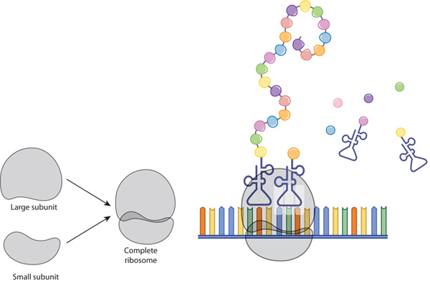
RNA Translation
Ribosomes are complexes of protein and rRNA
Large and Small subunits combine to form ribosome
Attracts tRNA carrying amino acids, appends to chain
Falls off mRNA at stop codon, releases protein
Figure from Nature Education, 2010
2
Notes:
Translation is the process in which a messenger or mRNA, is ‘read’ by a ribosome to produce an amino acid chain. A ribosome is composed of protein and ribosomal or rRNA, and is split into a large and small subunit. The two subunits combine at a ribosome binding site. The ribosome reads the codon and attracts a transport or tRNA complementary to this codon. The amino acid that tRNA carries is appended to the growing chain and the ribosome moves forward to the next codon. When the ribosome reaches the stop codon, the large and small subunits fall off the messenger RNA and the chain is released. This chain is subsequently modified to yield a protein.
Multiple ribosomes may perform translation on the same strand of mRNA. This process of RNA translation continues until the mRNA is degraded or destroyed, so long as there are sufficient resources to facilitate translation. These resources include ribosomes and tRNA with amino acids.

Slide 3
Ribosomal Flow Model
Tridiagonal SISO system
$${\dot{x}}_{1}= λ_{0}u\left(1−x_{1}\right)−λ_{1}x_{1}\left(1−x_{2}\right) \\ {\dot{x}}_{j}= λ_{j−1}x_{j−1}\left(1−x_{j}\right)−λ_{j}x_{j}(1−x_{j+1}) \\ {\dot{x}}_{n}=λ_{n−1}x_{n−1}\left(1−x_{n}\right)−λ_{n}x_{n} \\ y=λ_{n}x_{n}$$
$x_{j}:$ ribosomes in codon $j$
$λ_{j}$: initiation/elongation/separation rates
$y$: protein translation rate of mRNA
Notes:
The ribosomal flow model, or RFM, is an existing mean-field approximation to lattice models of rna translation. A state x is associated with each of the n codons on an mRNA. Xj may be interpreted as the probability that a ribosome is present at codon j at any time. Lambda0 is the initiation rate at which the mRNA attracts ribosomes, lambdaj is the elongation rate at which the ribosomes travel along the mRNA, and lambdan is the separation rate at which ribosomes fall off the mRNA. All lambdas are assumed to be positive. The quantity y is the resultant translation rate measured in units of protein per unit time.
The RFM is a SISO system with input u and output y. RFM dynamics are based on a parabolic current-density relation: the flux between adjacent codons depends on the probability that the previous codon has a ribosome and that the subsequent codon is ribosome.
The RFM with constant input u is globally asymptotically stable with a unique equilibrium point where all x are between 0 and 1. This equilibrium point can be found by solving a polynomial system, or by finding the eigendecomposition of a Jacobi matrix.
The diagram shows a 5-codon RFM at 2 seconds and at steady state. Each square box is a codon, and x is visualized as the proportion of gray fill in each box. The thicknesses of the gray lines are proportional to the ribosome flux. At steady state all fluxes are zero.

Slide 4
Ribosomal Networks
Multiple strands compete for ribosomes, codons $x_{j}^{i}$
$z$ ribosomes in pool, total conserved
$$z\left(t\right)+\sum_{i,j}{x_{j}^{i}}=N_{r}$$
Input based on saturation function $u=G^{i}\left(z\right)$
$\dot{z}\left(t\right)=−\sum_{j}{λ_{0}^{i}G^{i}\left(z\right)\left(1−x_{0}^{i}\right)}+\sum_{j}{λ_{n}^{i}x_{n}^{i}}$
Stable by contraction, nonzero steady states
Notes:
All mRNA inside a cell compete for a finite and possibly time-varying number of ribosomes. This competition inspired a RFM network model with a pool. The pool is filled with ribosomes that are not actively translating on strands of mRNA. Z is the number of ribosomes in the pool, and the total number of ribosomes Nr is a constant first integral of dynamics.
Each strand of mRNA I in the network is modeled by an RFM with an input Gi(z), where Gi is a monotonically increasing saturation function. Dynamics are stable by contraction arguments, with a unique nonzero equilibrium point.

Slide 5
Multiple mRNA (same rates, $λ=5$)
Notes:
This is a visualization of the RFM network model with 10 ribosomes and 3 strands of mRNA. All rates are lambda = 5. The steady state protein translation rate is 1.15 for each strand.

Slide 6
Multiple mRNA (bottleneck, $λ_{3}^{1}=0.05$)
Notes:
Here, Ribosomes cannot easily pass between codons 3 and 4 and this forms a bottleneck. Ribosomes are backed up on the first mRNA and therefore cannot translate the other strands. This globally reduces the translation capacity.

Slide 7
Multiple mRNA ($λ_{j}^{1}=3, λ_{j}^{2}=5$, $λ_{j}^{3}=10$)
Notes:
Here is a visualization where the strands of mRNA are not the same.
Ribosome network models can study competition effects between strands of mRNA. If any one lambda increases, then the steady state protein production rate on that strand increases. Protein production rates for all other strands will either rise or fall with the same sign.

Slide 8
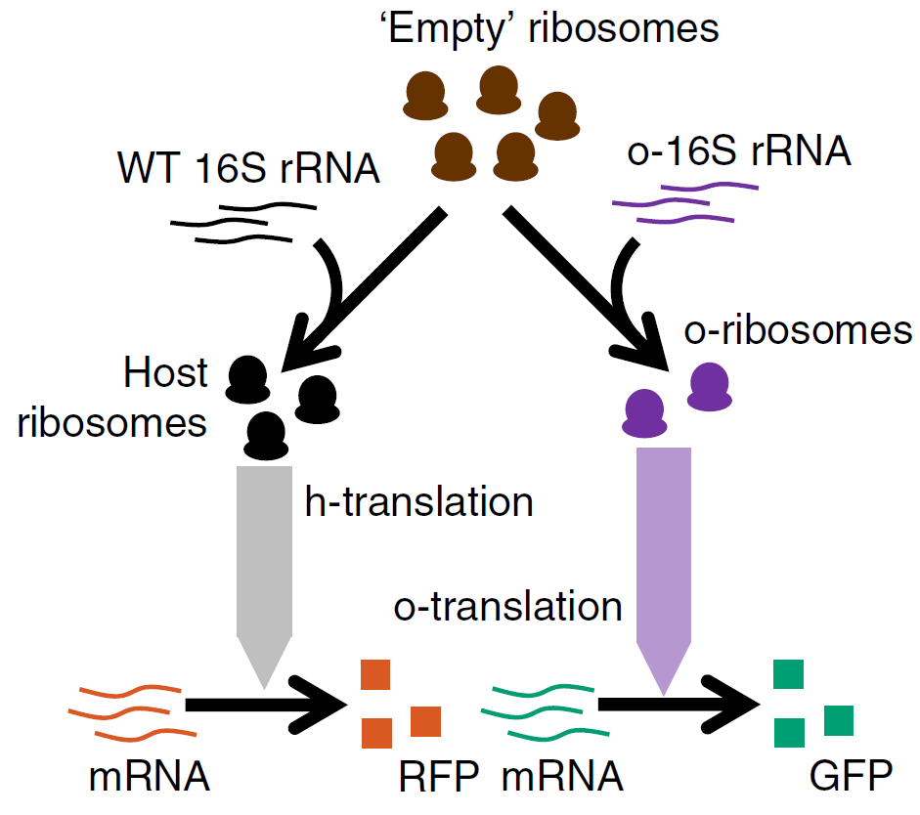
Orthogonal Ribosomes
Genetic circuits compete with host for ribosomes
Introduce ribosomes that only translate circuit genes
Host and Circuit pools are ‘orthogonal’
Figure from Darlington et. al, 2018
Notes:
One aspect of synthetic biology involves implanting genes into a cell to express new behaviors. These new genes are called circuit genes, and the cell’s original genes are called host genes. The host and circuit genes compete for ribosomes and other resources. The addition of circuit genes in some cases can slow down cell function or kill the cell due to this competition.
Orthogonal ribosomes are one method to reduce this competition. The ribosome binding sites on the circuit genes are designed such that host ribosomes are unlikely to translate the mRNA. Specially designed mutated ribosomes only translate the circuit genes, and do not translate the host genes. These mutated ribosomes are called orthogonal ribosomes, because the host and circuit pool of ribosomes are orthogonal.
This diagram from Darlington et. al. illustrates the decomposition into host and circuit ribosomes. The 16s rRNA on the small ribosomal subunit in E. coli is modified to produce orthogonal ribosomes. The ‘empty’ ribosome abstracts out the large ribosomal subunit and all other protein and rRNA. The complex of a wild-type or orthogonal 16srRNA and an empty ribosome is a host or circuit ribosome respectively.
The Darlington model is based on mass-action kinetics of protein translation and cell metabolism. In this work, we extend the ribosomal flow model to orthogonal ribosomes.

Slide 9
Orthogonal Ribosomal Flow Model (ORFM)
Occupancy $x_{j}^{pi}$: species $p$, strand $i$, codon $j$
Conservation law:
$$N_{r}=z_{E}+∑z_{p}+ ∑x_{j}^{pi}$$
Ribosome creation/degradation:
$$z_{E}\underset{k_{p}^{−}}{\underset{⇌}{k_{p}^{+}}}z_{p}$$
Globally Asymptotically Stable (Robust Lyapunov Function):
$$V\left(z, x\right)=\left|{\dot{z}}_{E}\right|+∑\left|{\dot{z}}_{p}\right|+ ∑\left|{\dot{x}}_{j}^{pi}\right|$$
Notes:
An Orthogonal Ribosomal Flow Model, or ORFM, involves p species of ribosomes translating mRNA. There are p+1 pools in total, the empty pool zE and each species’ pool zp. The state xpij corresponds to the occupancy of codon j of mRNA strand I that accepts ribosomes from species p. The total number of ribosomes remains conserved.
Ribosomes of species p are created from the empty pool at rate k+p and are degraded at rate k-p.
The ORFM is globally asymptotically stable, and this V(z, x) is a Robust Lyapunov function certifying stability. This unique steady state can be computed by bisection.

Slide 10
Orthogonal Ribosome System (high demand)
Notes:
In this animation, the empty ribosomes are purple, host ribosomes are blue, and circuit ribosomes are red. The system has 10 total ribosomes. The thickness of the lines between pools is proportional to the rate of ribosome creation or degradation. All rates kp are equal to 1.

Slide 11
Orthogonal Ribosome System (no demand)
Notes:
There are no strands of mRNA accepting circuit ribosomes. Circuits introduce a deadweight loss because z1=z2=zE.

Slide 12
Three Species System
Notes:
This system has three types of ribosomal species with 20 ribosomes in total. The rates k are each 0.1, and the number of ribosomes in each pool at equilibrium is 0.286.

Slide 13
Optimization Problem
Maximize steady-state weighted protein throughput
$$y_{w}=\sum_{pi}{w^{pi}y^{pi}}$$
Adjust constants $K_{p}=k_{p}^{+}/k_{p}^{−}$
Generically non-concave optimization problem
Notes:
An optimization problem can be posed to maximize the weighted protein output of the ORFM. The output of strand I accepting ribosomes of species p is ypi. The weighted output yw is the weighted sum of all outputs with coefficients wpi. The weight wpi reflects the desirability of the protein produced by strand pi.
The equilibrium rate constant Kp is the ratio between the creation rate and degradation rate of species p. It is desired to maximize yw at steady state while adjusting the rate constants Kp within a range.
The independent variables of this optimization problem are the rate constants K. Given K, the steady state yw may be evaluated by the ORFM bisection algorithm. The optimization problem is generically non-concave. The figure on the right plots the optimization landscape of maximizing the total protein output of an ORFM, to be shown in the next slide.

Slide 14
Maximize Total Output ($w^{pi}=1$)
Parity$: K=\left[5, 5\right], y_{w}=3.11$
Optimized: $K=\left[5, 0.735\right], y_{w}=3.38$
Notes:
Total protein output can be specified by setting all weights wpi to 1. When each equilibrium rate constant is 5 the total output is 3.11. This is shown on the left-hand plot, under the heading parity. Solving the maximization problem with a grid search yields the parameters on the right hand plot with a total output of 3.38. This optimized K reduces the number of circuit ribosomes in the system, and the effect of this reduction is visible in the lowered occupancies of the circuit mRNA.

Slide 15
Feedback controller
$${\dot{F}}_{p}=λ_{n}^{pF}x_{n}^{pF}−δ_{p}F_{p} \\ k_{p}^{+}=k_{p}^{+0}\frac{1}{{\left(1+\frac{F_{p}}{F_{p}^{0}}\right)}^{γ_{p}}}$$
Reduce wasted (unused) circuit ribosomes
Add a Hill-type inhibitor
mRNA translated by circuit ribosomes
Protein $F_{p}$represses tagging of circuit ribosomes
Figure from Darlington et. al, 2018
Notes:
Previously there was a case where a system with no circuit demand still produced circuit ribosomes, ideally a feedback controller would generate species ribosomes only as needed.
In their mass-action kinetics model, Darlington et. Al. introduced a feedback controller on orthogonal ribosomes. Translation of a special strand of mRNA yields a protein Fp. The production rate of ribosomes of species p is reduced by a Hill-like term based on the current amount of inhibitory protein Fp. The protein Fp degrades at rate deltap.

Slide 16
Repressed Ribosome System (no demand)
Notes:
The golden strand is the special mRNA that produces inhibitory protein. The initial rate of this inhibitory mRNA is 0.005 to ensure that other circuit mRNA strands are prioritized over the inhibitory strand.
This inhibitor has parameters F0=1.2, gamma =4, and delta = 0.01.
Without the inhibitor, the expected number of host ribosomes at steady state is 7.63. This number of host ribosomes rises to 7.97 after the inhibitor Is added, because the inhibitor winds down the production of circuit ribosomes. The amount of inhibitory protein at steady state is 0.292 units.

Slide 17
Repressed Ribosome System (high demand)
Notes:
Without the inhibitor, the total protein output is 4.98. With the inhibitor, the total non-inhibitory protein output is 5.06. The number of host ribosomes increases as a result of using the inhibitor, and the steady state amount of protein is 0.138 units.
Future work includes further investigation of this feedback controller.

Slide 18
Crosstalk Model
Notes:
The ORFM model presented previously assumes perfect orthogonality between ribosomes of different species. In reality there will be a slight amount of crosstalk, such as the case where circuit ribosomes translate a host mRNA 2% of the time.
In this animation, all mRNA accept ribosomes from both the host and circuit pools. This crosstalk RFM is globally asymptotically stable if the lambdas on each are identical between ribosomal species except for a possibly differing initiation rate. We believe that the crosstalk RFM where ribosomes can travel at species-dependent rates along mRNA is also stable, and proving this theory is future work.

Slide 19
Conclusion
Genetic circuits compete for ribosomes with host
Can split pools to reduce competition
Extended RFM to ORFM
Optimization problem to maximize throughput
Inhibiting feedback controller
Notes:
Here are some take-aways from this talk. Orthogonal ribosomes may be able to reduce competition for resources inside cells. We introduced and analyzed the ORFM to model ribosome competition in the presence of orthogonal ribosomes. Applications include an optimization problem and a feedback controller.

Slide 20
Thank you for your attention
Questions?
Code: https://gitlab.com/jarmill/Ribosomes
Notes:
Thank you for attending this presentation. Our MATLAB code is available at this gitlab link.

